Slide 1
DIRECTION, NOT DUPLICATION
COLLABORATIVE CASE PLANNING THAT WORKS
WATCP FALL CONFERENCE 2026

Slide 2
COMPREHENSIVE COLLABORATIVE CASE PLANNING
A shared, participant-informed plan that connects legal requirements, assessed risk and needs, responsivity needs, strengths, recovery capital, services, and measurable next steps—while assigning clear ownership across the team.
SHARED
PARTICIPANT-CENTERED
ASSESSMENT-LED
The team works from the same direction.
The participant’s goals, strengths, and perspective shape the plan.
Priorities are anchored in validated assessment and clinical information.
ROLE-DEFINED
RECOVERY CAPITAL
OWNERSHIP
Each partner contributes their own expertise and respects the expertise of others
The plan increases the internal and external resources to start and sustain recovery.
Each partner knows what they own, contribute, and do not own.

Slide 3
WHY CHANGE TO COLLABORATIVE CASE PLANNING
  17% increase in short-term compliance (Lerman, et. al. 2025)
  14% decrease in revocations (Ibid.)
  Quality cooperative case plans have been linked to fewer violations and revocations (Gossner, et al. 2016)
  Case plans enhance participant’s perception of fairness
  Improved job satisfaction was reported when there was collaboration between community supervision and treatment providers (Welsh et al., 2016)
Gossner, Simon, Rector, & Ruddell (2016)

Slide 4
THE FEAR
Overload
More Voices
More Goals
More Data
Assessments, reports, notes, recommendations
Treatment, supervision, case management, providers, court, attorneys
Compliance, safety, recovery, criminogenic needs, responsivity, client goals, stability
More Meetings
Staffing, treatment team, case conference
More Documents
Conditions, referrals, reports, plans, updates

Slide 5

A USEFUL PLAN GIVES EVERYONE DIRECTION
The case plan should make decisions clearer by streamlining information
Focus Attention
  Actionable information
  Will it change a decision?
Clarify Ownership
  Define responsibilities
  Define decision makers
Define Behavior
  Observable goals
Repeatable workflow
  Communication system

Slide 6
CCCP AS A DECISION SYSTEM
Information
What do we need to know?
  Assessments, clinical reports, participant information, records, recommendations
Priority
What matters right now?
  Safety, stability, risk-relevant needs, recovery, engagement
Goal
What is the change we want to see?
  Behavior, skill, outcome
Action
What concrete steps and supports lead to the goal?
  Skill practice, referral, support, treatment
Review
How will we know? Where do we go next?
  Observable evidence, timeframe, flexibility, adjustment, sequencing, process

Slide 7
THE “LESS IS MORE” TEST
Keep / Connect
Does this identity a priority?
Does this help choose a next step?
Does this clarify the plan or an issue?
Doe this help to understand the plan?
Reconsider / Cut
Is this necessary to make a decision?
Does this change how we see progress?
Does this identify a strength, challenge, or barrier?
Information that is agreed on, it is established that everyone knows, or hasn’t changed
When the purpose or function cannot be clearly explained
Not related to a function of the court, program, treatment, or individual
Every possible fact or story
Opinions outside of role and expertise
Comprehensive ≠ exhaustive
A case plan earns its place by making work clearer.

Slide 8
Building The Operating System
Start with policy, procedure, roles, and routines
*All charts are examples only

Slide 9
START AT THE TOP
Concept
Program definition of success
Infrastructure
Program mission statement
Policies and procedures
Challenges
Partners with too much or too little ownership
Overlapping responsibility, ownership, interests
NOT just “completion” or “abstinence”
Client process mapping
Identify decision points
Clarify authority, expertise, responsibility
Design information flow around decision making
Examine what “partners” means
Team member role descriptions
Communication, reporting, and meeting protocols
Provider contracts, MOUs, and agreements
Consent, confidentiality, and information sharing
Performance, QA, and outcome measures
Responsibility for “closing the loop”
All new responsibilities falling on a single individual
Partner splitting
Multiple voices delivering different messages
Referral procedures
Partner process mapping
Trust
Process for resolving disagreements
Training, support, and buy-in
Expand your definition

Slide 10
BASIC ROLES AND RESPONSIBILITIES
Role | Responsibility |  | Contribution
Participant | Collaborate Practice | Communicate Change | Personal Priorities Preferences | Strengths Feedback
Case manager | Coordinate Connect | Track Support | Planning Integration Referrals | Follow-through Update / Report
Supervision / Police Liaison | Monitor Verify | Communicate Safeguard | Public Safety Fact gathering | Coordinate
Treatment provider | Assess Evaluate | Treat Recommend | Recommendations Treatment Goals | Progress
Judge / court | Decide Reinforce | Respond Safeguard | Expectations Rights & Due Process | Orders Responses
Defense | Represent Advise | Advocate Safeguard | Legal Advice Rights & Due Process | Advocacy
Prosecutor | Evaluate Advise | Safeguard | Rights and Due Process | Victim’s Interests Public Safety
Service Partners | Connect | Support | Resources | Supports

Slide 11
MAKING DECISION DECISIONS
Who decides?
Who gives recommendations?
Who must be consulted?
Who must be informed?
Who communicates the decision?
Who follows up?
For each answer:
  Is it their role?
  Is it within their capacity?
  Decision rules:
    Clinical decisions: only clinicians treating the client
    Supervision-related: supervision staff
    Legal decisions: judge
    Legal advice: defense counsel
    Prosecutorial decision: prosecutor
    Coordination: Case manager
    Shared: collaborative but final decision from legal or professional authority
    *Always follow applicable law, rules, professional scope of practice

Slide 12
WHO MAKES DECISIONS
Decision | Lead Authority | Others Contribute
Clinical assessment and treatment | Clinician | Participant, supervision, case manager
Supervision strategy and monitoring | Supervision (case manager for some programs) | Participant, case manager
Program goals and action steps | Case manager | Participant, treatment, supervision
Court response and legal requirements | Judge | Informed by participant, case manager, supervision, attorneys
Legal advice and representation | Defense counsel | Participant
Public Safety | Supervision, police liaison, or prosecutor | Judge, team as appropriate
Practical supports and referrals | Case management | Participant, treatment, supervision
Phase advancement | Objective criteria + multidisciplinary input → Judge | Full team
Could break contributions specifically to who recommends, consults, must be informed, communicates, and who and how they follow-up

Slide 13
DESIGN WORKFLOW AROUND PURPOSE
Communication | Primary Purpose | When | Participants | Output
Collaborative Case Conference | Coordinate priorities, supports, and services | Intake, phase change, significant changes | Participant, case manager, supervision, treatment, partners who own next steps | Case plan → participant and involved team members
Treatment / Clinical Coordination | Coordinate assessment, treatment recommendations, clinical concerns | Determined by treatment provider or request by team | Relevant treatment providers and clinicians | Treatment adjustment recommendation → authorized providers, case manager
Staffing / Pre-Court Review | Review progress, setbacks, and develop coordinated court response | Based on schedule or violations | Core treatment court team, partners with decision-relevant information | Team recommendation, rationale, proposed response → Judge
Urgent Risk / Safety | Respond quickly to immediate risk | Crisis, serious law enforcement contact, safety concerns | Only necessary decision makers and qualified professionals | Immediate action and follow-up plan/report → Supervision, case management, required team members
Referral / Service Barrier | Connect and ensure supportive services | Responsivity issue, need | Participant, case manager, provider | Updates → case manager

Slide 14
TAKEAWAYS
Comprehensive collaborative case planning requires reexamination of the program as a whole
  It is more than a case management adjustment
  It requires the whole team
  Be critical in your examination of existing norms
The more structure you create on the front end the easier it becomes on the back end
Regularly revisit this step, don’t be afraid to adjust
Alignment does not mean one plan or one document. It means a structure to streamline compatible priorities, coordinated timing, shared awareness, and clear ownership across plans.

Slide 15
Roles and Communication
Contribute With Purpose

Slide 16
MORE INFORMTATION DOES NOT MEAN MORE EFFECTIVE
Extraneous information obscures real issues
  Confuses decision making
  Increases biased and non-EBP decision making
Details that matter:
  Identify a need, pattern, barrier, strength, or opportunity
  Could affect decision or next action
  Is within our role and responsibility
  Clarify uncertainty
  Curiosity or habit, beyond what is needed to act, is just a distraction

Slide 17
THE INFORMATION WE NEED
  Does the information serve a clear purpose?
  What part of the information is necessary for that purpose?
Could it change what we do next?
Purpose | Useful information answers…
Progress | What happened with the behavior goal or expectation?
Contributing Factors | What contributed to progress or difficulty? What can we build on or address?
Attention Needed | What specific issue requires coordination, input, or a decision?
Responsibility | Who needs to do or coordinate something? Input? Output?
Progress | What changed in the target behavior?
Decision | What choice requires attention now?

Slide 18
MAKE QUESTIONS SPECIFIC
Broad request | Focused replacement
Tell me what happened. | Tell me what I need to know to make this decision?
What else? And then? | What do I need to understand so we can make a useful plan?
What did [provider] discuss in therapy? | What skill needs reinforcement outside treatment?
Send your notes or a summary. | Send relevant progress, barriers, recommendations, and decisions needed.
What else is wrong in their life? | Which issue is interfering with the current priority?
Are they doing well? | What have they demonstrated and what support remains?
What else should we know? | Is there a decision, action, or coordination issue the team needs to consider?

Slide 19
INFORMATION FILTER
Authorized
Relevant
Necessary
Actionable

Slide 20
LINES OF COMMUNICATION
Create standing communication agreements
  Who, method, format, when, response if needed
Set the policy, procedures and routine once
  Use the same format and the same channels
    Adjust content or frequency for the individual when needed
From / To | Information | How/When
Case Manager → Provider | Relevant changes Coordination needs Court deadlines | By email, at least 1 week before any meeting or court deadline and as needed
Provider → Case Manager | Attendance Assessment results Treatment progress Recommendations | Verified through secure channel based on release/consent/privacy Report form by email at least 3 days before meeting or court and as needed
Case Manager → Court Team | Compliance Goal progress Decision needed / recommendation / next steps | Pre-staffing form sent by email at least 2 workdays before scheduled staffing Send responses about questions of fact, other recommendations

Slide 21
BEST PRACTICES
  Create a written plan and written policy, don’t wing it.
Close the loop
  If action is required identify who responds, when, and who confirms
Create clear defined lines of communications between case plan and individual treatment plans
  Enough information to coordinate, reinforce, and not duplicate without being overwhelming
Don’t forget the participant
  Include their perspective before revising the plan
  Check for understanding
  This is their plan
Communicate changes
  Highlight changes that are relevant
  Don’t let changes be a surprise
Share appropriately and accurately
  Stress appropriate channels and applicable privacy / disclosure

Slide 22
Including Participants
This Is THEIR Plan

Slide 23
THEY ARE THE EXPERTS IN THEMSELVES
  Where CAN we include them? Do they have to be there?
Before the Meeting
Explain the purpose and who will attend
Ask what the participant wants noted
During the Meeting
Begin with their perspective
Get their view before discussing decisions
After the Meeting
Summarize the decision and next step
Review relevant information with them
Ask for and address their concerns, questions
Use plain language
Ask what they think will work
Ask what they are willing to do or try
Explain the process and reason the decision was reached
Confirm their understanding in plain language
Discuss next steps

Slide 24
VOICE CHECK
  Make sure the plan belongs to the participant and not the other way around.
Did we ask for the participant’s perspective before presenting the team’s conclusions?
Did we ask more than just what was wrong?
  Did we ask what matters?
  Did we ask what their ideas were?
Did we listen for, and highlight, their strengths and preferences?
Did we create enough space for the participant to disagree?
Did we avoid treating silence as agreement?
Did we clearly separate legal requirements from negotiable plan choices?
Did their contributions influence the decision, goals, or next steps?
Did we identify what they are willing and able to do?
Can they explain what happened in their own words?
Did we acknowledge and document disagreement and unresolved concerns?
Did we tell the participant what happens next and who is responsible?
  Were they invited merely to speak or did they have a voice?

Slide 25
HOW YOU TALK MATTERS
  If they heard what you said when they were not around:
  Would you be comfortable with them hearing it?
  Would all team members be comfortable hearing it?
  Would you be okay with someone saying it about you?
  Would it help them or hurt them?
  Write and speak as though the participant may eventually hear or review what you said

Slide 26
Creating Behavior Based Goals
Moving to action

Slide 27
WHAT HAS CHANGED
Moving away from outcome-based goals
  “Absence of evidence is not evidence of absence” – Carl Sagan
    Is it really change or something else (environment/opportunity/fear of punishment)?
  “One swallow does not a spring make” - Aristotle
    Do we have a reason to believe the change is sustainable?
  “If you do not have the small skills, you cannot master the large ones; you will fail at the very edge of success” – Sun Tzu
    Do they have the actual skills to maintain the change?
  “If a man does not keep pace with his companions, perhaps it is because he hears a different drummer” – Henry David Thoreau
    Outcome-based goals make differentiation difficult
  “Success is a journey, not a destination. The doing is often more important than the outcome” – Arthur Ashe
    Outcome based goals make it more difficult to praise progress

Slide 28
POSITIVE-PRESENCE GOALS
“A man is not good because he does no evil, but because he does good.” – John D. Morley
Define what participants will do, not only what they won’t do
Positive-presence goals name the actions, skills, or pattern that lead to and sustain the outcome
Focus on specific actions that demonstrate ability
  Not “just do it” or “do better”
Absence-Focused Goal | Positive-Presence Goal
No substance use | Demonstrate specific coping response and seeks support
Attend all appointments | Use a scheduling plan and demonstrate problem-solving skills related to transportation barriers
No contact with drug using friends / codefendants | Practice refusal and exit skills Increase contact with pro-social peers

Slide 29
SETTING GOALS
Identify What Matters
Responsivity
Treatment Assessment
Choose What to Work On
Most Immediate Need
What Is Achievable Now
(Proximal, Distal, and Readiness)
Define The Goal
Desired Behavior
Program Requirements
What Must Come First/Next
(Sequencing)
Action Steps and Ownership
Readiness
Criminogenic Needs Assessment
Recovery Capital
Measurable Behavior Markers
Connected To Need
Managable Steps
Timing And Sequencing
Servies And Interventions
Ownership And Communication
Participant Priorities

Slide 30
MANAGED / PROXIMAL / DISTAL
Conscious Incompetence
Conscious Competence
Unconscious Competence
Unconscious Incompetence
 | Definition | Markers
Managed | Able to consistently and generally sustain the behavior and reasonably expected to continue | Consistency over time Expectations sufficiently met Not perfection Maintenance may still require attention and reinforcement
Proximal | Often able to sustain the behavior with reasonable effort but not consistently Current capabilities and support are sufficient | Has necessary skills and supports Barriers sufficiently addressed Sustained behavior is achievable Motivation and habits still need work
Distal | Unable to reliably achieve the behavior with reasonable effort Necessary stability, skills, resources or readiness are insufficient | Stability, skills, or resources insufficient Barriers or symptoms interfere

Slide 31
GOAL COMPONENTS
Goal Components | Purpose
Priority and Purpose | What needs attention? Why now?
Participant Goal | What behavior will change?
Action Steps | What the participant will do that builds toward the change target?
Service/Staff Commitments | Who will provide what support, services, or information?
Progress Criteria | How will we know the steps are leading to the desired change?
Each part connects: the need guides the goal, the steps and supports help achieve it, and the criteria show progress.
The participant and team should understand what matters, who does what, and how progress will be recognized.
If you cannot explain the reason for each component AND how they are connected, you need to reconsider the goal

Slide 32
WRITING OBSERVABLE GOALS
Define the outcome AND what should happen instead
  What is the participant doing
    The specific behavior
  Evidence it is working
    One or more of the following
      SMART Goals
  Specific
    What will they do?
  Measurable
    How will we know?
  Achievable
    Is this within current ability?
  Relevant
    Does it address what matters now?
  Time-bound
    When will progress be reviewed
Frequency
Opportunity
Quality
How often the participant uses the behavior
Is it used when a relevant situation occurs
Can they demonstrate the skill to fidelity
Support
Are they able to demonstrate the skill without assistance
Application
Can they use the skill outside of coached practice

Slide 33
WRITING OBSERVABLE GOALS
      SMART Goals
  Specific
    What will they do?
  Measurable
    How will we know?
  Achievable
    Is this within current ability?
  Relevant
    Does it address what matters now?
  Time-bound
    When will progress be reviewed
 | Outcome Based Goal | Positive-Presence Goal
Specific | Bob will attend all appointments | Bob will set phone reminders Bob will develop a transportation plan
Measurable | Attendance records | Show alerts in phone Verbally describe transportation plan
Achievable No significant barrier Has skills Has support | Yes, reasonably achievable with some support | Yes, immediately achievable Yes, achievable with practice
Relevant | Outcome required | Sequenced Connected to outcome
Time-bound | Completed by … At least three times before … For two consecutive weeks …

Slide 34
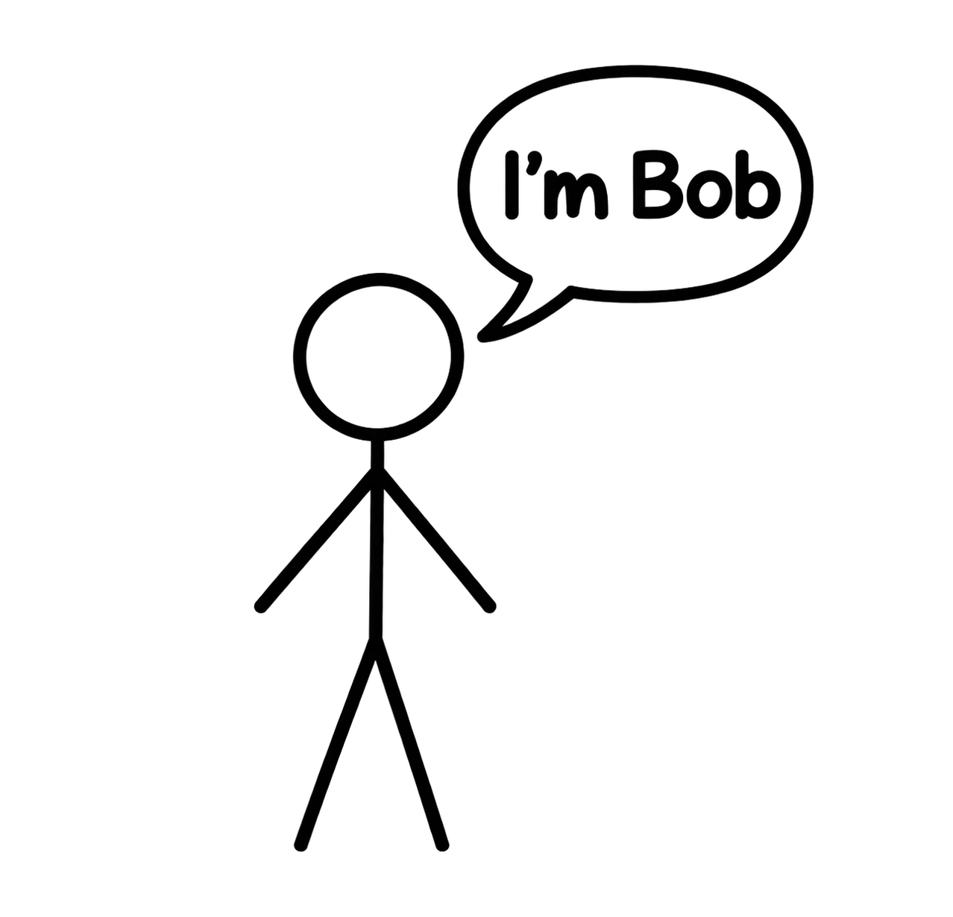
WRITING OBSERVABLE GOALS
Goal Components | Example
Priority and Purpose | Difficulty remembering appointments and arranging transportation in advance has interfered with Bob’s ability to benefit from treatment.
Participant Goal | Bob will use an appointment-planning routine and problem-solve transportation barriers in advance so he can attend scheduled treatment appointments.
Action Steps | Remembering - Bob will show his case manager the alarms he has set in his phone during each case management meeting. Transportation barrier – Bob will explanation his transportation plan, and a backup plan, for the upcoming week during each case management meeting.
Service/Staff Commitments | The case manager will assist Bob with using scheduled reminders on phone. The case manager will engage in problem solving practice with Bob regarding transportation planning and provide assistance when needed. The provider will supply appointment schedule and report attendance on a weekly basis by email to case manager.
Progress Criteria | Bob will maintain an appointment and transportation plan so he can attend scheduled appointments over the next two weeks.

Slide 35
WHEN GOALS ARE NOT MET
      Situation: Bob missed his appointment when his ride cancelled. He did contact his backup, but they were unable to pick him up in time. He contacted the service provider and rescheduled.
      Outcome: Appointment missed
      Target Behavior: Planning / Problem Solving
      Expectation Criteria: Met (alarm and plan)
      Next Step: Improve transportation options, maintain setting alarm and transportation plan)
What progress was made?
  Any steps completed? Attempted?
Was the step achievable?
  Was it clear?
  Did they have the necessary skills and support to be successful?
  Were there competing goals?
What got in the way?
  What, if anything, might we have to change?
  What has the participant learned?
What helped?
  Build on any element that was successful.
What, if anything, should we adjust together?
  Make the change and set the next review.

Slide 36
REPEAT THE CYCLE
Set Goal
Define Action Steps
Review Progress
Adjust
Verify Achievement
4 or fewer proximal goals at a time

Slide 37
HOW PHASES CONNECT?
2026 Standards
Phases should be connected to objective, observable behavior and management of appripriate proximal goals
  Defines what matters most right now
  Sequences skills, behaviors, and goals
  Avoids overload
  Matches expectations to ability
  Behavior based goals
    Moves beyond time/sobriety/completion
Notes:
The four dimensions of procedural justice in the All Rise discussion are respect, voice, neutrality, and trustworthiness. Transparency is a practical behavior that supports them. If facts are contested or liberty is at stake, allow necessary process and counsel; brevity does not supersede legal rights.
All Rise. (2026). Adult Treatment Court Best Practice Standards, January 2026, pp. 29–38, 151–170. https://allrise.org/wp-content/uploads/2026/01/All-Rise_Adult-Treatment-Court-Best-Practice-Standards_January-2026-4.pdf

Slide 38
PHASE STRUCTURE
PHASE 1 | PHASE 2 | PHASE 3 | PHASE 4 | PHASE 5
  Acute Stabilization
    Orientation
      Assessment
        Responsivity
          Case Plan
< 2 Months
  Address Criminogenic Needs
    Skill Building
      Prosocial Engagement
        Life Skills
          Abstinence
  Recovery Management
    Build Independence
      Increase Community Connections
        Address Holistic Needs
Notes:
The four dimensions of procedural justice in the All Rise discussion are respect, voice, neutrality, and trustworthiness. Transparency is a practical behavior that supports them. If facts are contested or liberty is at stake, allow necessary process and counsel; brevity does not supersede legal rights.
All Rise. (2026). Adult Treatment Court Best Practice Standards, January 2026, pp. 29–38, 151–170. https://allrise.org/wp-content/uploads/2026/01/All-Rise_Adult-Treatment-Court-Best-Practice-Standards_January-2026-4.pdf

Slide 39
TAKEAWAYS
Goals must serve a purpose for the individual based on their unique needs
Goals must include the presence of a skill, behavior, or action
  What is done to achieve the goal
Outcomes are an indication that a goal has been reached
  It may be possible to achieve a goal without achieving the outcome
Sequence action steps to achieve goals
Adjust goals based on phase expectations

Slide 40
Summary
Being intentional

Slide 41
TAKEAWAYS
A shared, participant-informed plan that connects legal requirements, assessed risk and needs, behavioral-health needs, strengths, services, and measurable next steps—while assigning clear ownership across the team.
Instead of… | We create…
Reacting case by case | Repeatable systems
More information | Useful information
More voices | Defined roles
More goals | Clear priorities
More meetings | Purposeful communication
Compliance-only expectations | Observable behavior change
Staff-owned plans | Participant-informed plans
Separate plans | Connected next steps

Slide 42
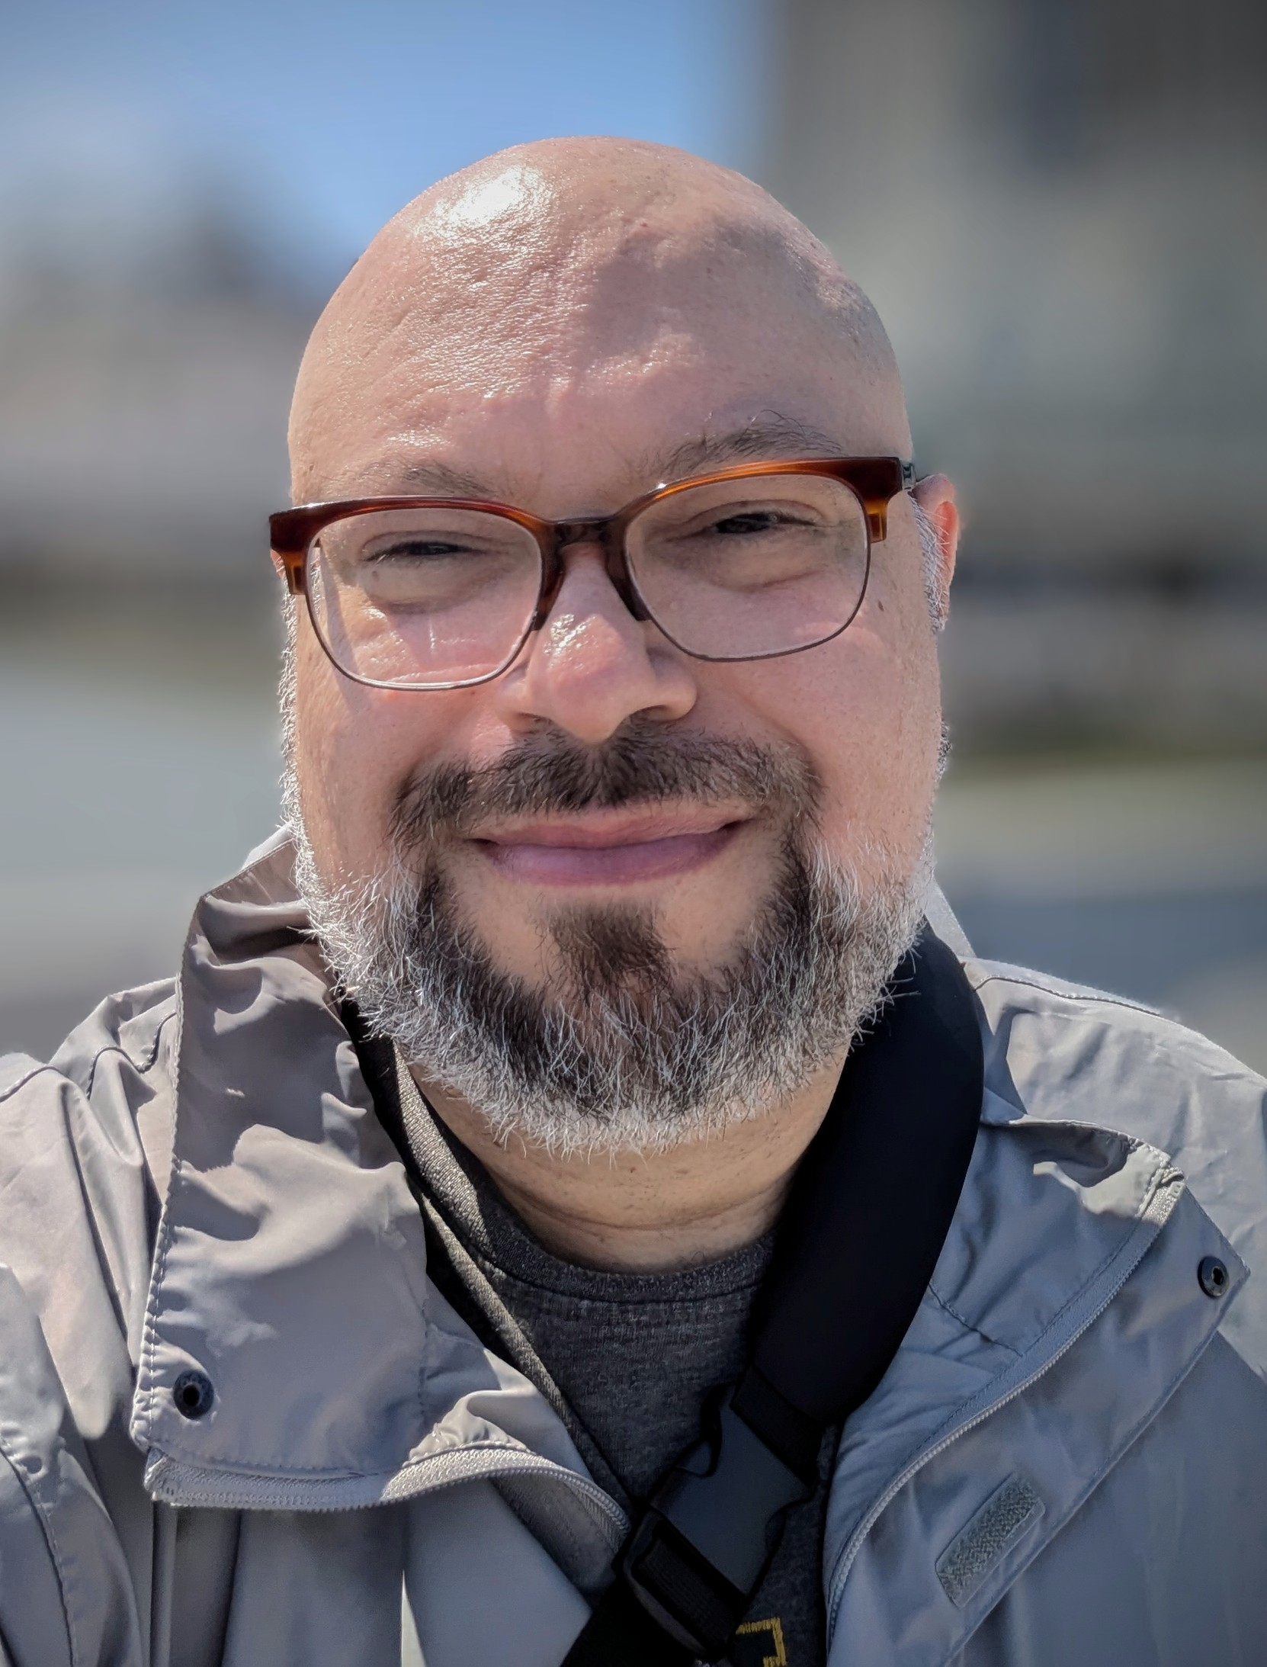
CONTACT INFORMATION
JASON CHAPMAN
Training and Quality Assurance Coordinator, JusticePoint
jchapman@justicepoint.org
Cell: 262-825-4245

